Slide 1
DCF Modeling for Valuation Week 12.2
Professor Burnes
Leeds School of Business
University of Colorado Boulder
Leeds
B U S I N E S S
Page 1

Slide 2
Today
AI
TVM
DCF

Slide 3
Time Value of Money
PV
Net Present Value
Perpetuity

Slide 4
Present Value
Recall that Present Value provides a basis for “apples to apples” comparison for cash flows that occur at different times.
We do this by understanding:
Cash Flow
Time
Interest Rates

Slide 5
Example 1:
What is the value TODAY (present value) or receiving $120,000 in 12 years if the interest rate is 8%
Let’s solve in Excel, please see the Present Value Tab

Slide 6
Example 2
Now, you are going to not only get a Payoff (cashflow) at the END of a project, but you are going to get annual payments along the way.
?? What is the Present Value of an Project that offers $120,000 in 10 years, AND $3200 per year if your interest rate is 8%?

Slide 7
Net Present Value
The NPV model is relevant when we have DIFFERING cashflows over time.

Slide 8
Example 3: NPV
Year | Cashflows
1 | 10000
2 | 12000
3 | 25000
4 | 45000
5 | 75000
What is the Present Value of a project with the following cashflows, if your interest rate is 9%

Slide 9
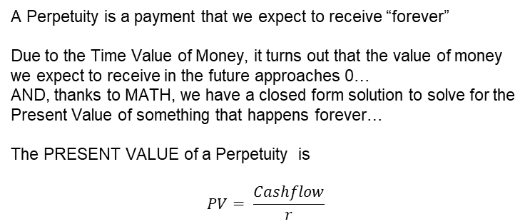
Perpetuity
A Perpetuity is a payment that we expect to receive “forever”
Due to the Time Value of Money, it turns out that the value of money we expect to receive in the future approaches 0…
AND, thanks to MATH, we have a closed form solution to solve for the Present Value of something that happens forever…
The PRESENT VALUE of a Perpetuity is
$$PV= \frac{Cashflow}{r}$$

Slide 10
Example 4: Perpetuity
What is the Present Value of an offer that promises you $1525 forever, if your interest rate is 12%?

Slide 11
We are going to an “NPV Analysis” Building a DCF Model that includes a “Terminal Value”
The Analysis is based on a 5 year pro forma
We understand NPV
And we apply a “Perpetuity Model” to calculate a Terminal Value
We build a Discounted Cash Flow (DCF) Model – based on our understanding of the Cash Build and Burn within the Business

Slide 12
The Cash Flows we use in a DCF Model are
Net Income
+
Depreciation
-
Change in Required NWC
-
CAPEX
Operating Free Cash Flows

Slide 13
Picture of the DCF

Slide 14
We are going to be using the Excel ESBM4570_12.2

Slide 15
Start with Net Income
Complete the Assumptions by using the 2023 Actuals.
Create your values as a % of revenue
Growth and Taxes are given otherwise
Note that this fills in your 2024-2027 projections
Complete 2028 through Net Income

Slide 16
The Role of Depreciation
Depreciation is a non cash expense
I have highlighted it so that you can find it when we calculate our Cash Flows from Operations

Slide 17
“Required” Net Working Capital
This is Net Operating Working Capital + “required cash”
It is a bit nuanced, and a business assumption/decision you need to make
Required cash is how much cash do you need to have “on hand”, that is “tied up” in your business, that you are not going to spend on GROWTH.
It is:
Required Cash + A/R + Inventory – A/P – (Other Short Term Notes)

Slide 18
Please Build your Required Net Working Capital
Let’s assume 10% of our cash is ‘required’ to have on hand (can’t touch for ops/growth)

Slide 19
We need to subtract our Annual CAPEX
Bring Gross PP&E into CAPEX
Calculate Annual Change – this is annual expenditure
Let’s do it Now!

Slide 20
Now… Calculate your Annual Operating Free Cash Flow

Slide 21
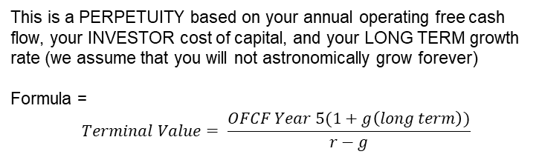
Calculate your Terminal Value in Year 5
This is a PERPETUITY based on your annual operating free cash flow, your INVESTOR cost of capital, and your LONG TERM growth rate (we assume that you will not astronomically grow forever)
Formula =
$$Terminal Value= \frac{OFCF Year 5(1+g\left(long term\right))}{r−g}$$

Slide 22
Fill in the Total FCF Line
NOTE: you have Cash Flows of Differing Values!
NOW: You can apply the NPV model to calculate the value of the Firm Using a Discounted Cash Flow approach!

Slide 23
DCF Model
The PV of the FIRM =
PV OCF + PV (Terminal Value)
Terminal Value = Perpetuity Value of firm at it’s “forever” growth rate, and INVESTOR required return

Slide 24
Finally.. The implication
The Value of the Company is the Present Value of its Cash Flows.
In this case, it is $106,412
This would be your starting point for your Scorecard!

Slide 25
Thanks!
Monday:
Lady M:
Write Up:
Team 9
Team 6
Team 5
Presenting:
Team 6
Team 5
Responding:
Team 4
Team 10
Team 8

